Slide 1
PYTHON STAR TECHIES
GROUP MEMBERS:
Pranav Shekhar - PXS190078
Aastha Koshta - AXK200013
Sneha Agrawal - SXA210285
Puzah Kasulla - PXK210067
Object Oriented Programming -Python
MIS 6382 - 502

Slide 2
INTRODUCTION
COLUMN NAME | DESCRIPTION
Restaurant Name | Name of the Restaurant
Cuisine | Name of the cuisine
Open Hours | Open Hours of the Restaurant
State | Restaurants in State
Cnty_GeoId | County Geographical Id
Cnty_Name | County Name
UA_GeoId | Urban Area Geographical Id
UA_Name | Urban Area Name
MSA_GeoId | Metropolitan statistical area GEOID
MSA_Name | The name of the metropolitan statistical area where the restaurant is located
Lon | Longitude of the restaurant
Lat | Latitude of the restaurant
Frequency | Frequency of the restaurant
isChain | A binary indicator that is 1 if the restaurant frequency > 5 else 0
We have a dataset examining the Most Popular Chains of US Restaurants. The data was collected on April, 2021. It was mainly cleaned through correcting the restaurant names and merging chain branches. The restaurant data was also spatial joined with county, urban area, and metropolitan statistical area shapefiles. Thus, the final dataset has the following columns:

Slide 3
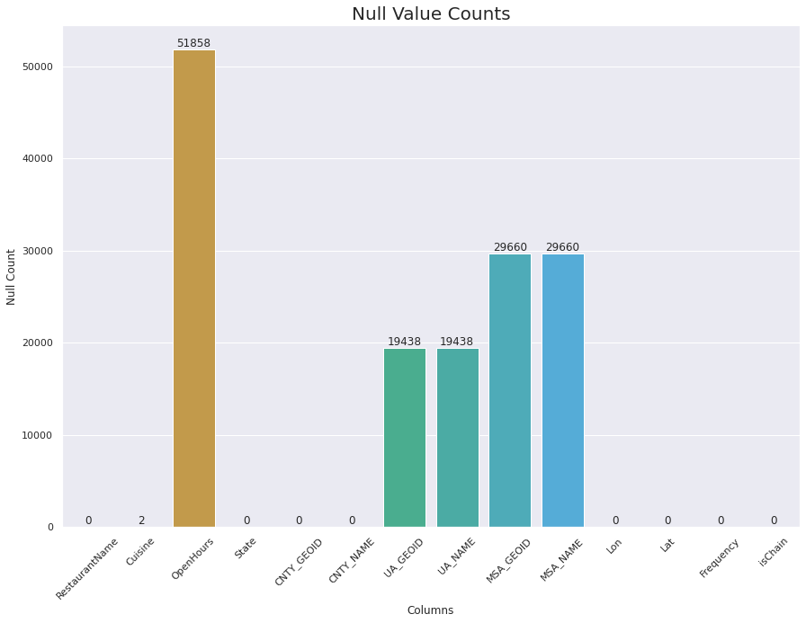
Missing values in Data
Cuisine has 2 and Open Hours has 5k missing values.
These are categorical values and were handled by mode of the respective fields.

Slide 4

OBJECTIVE
To open a restaurant in the US we need:
Location
Type of Cuisines
Operating Hours of Restaurants

Slide 5
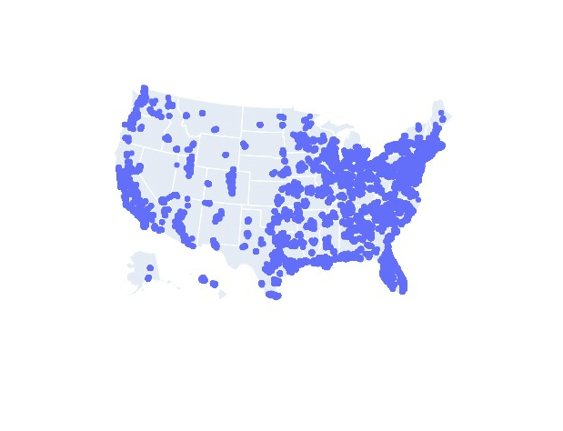
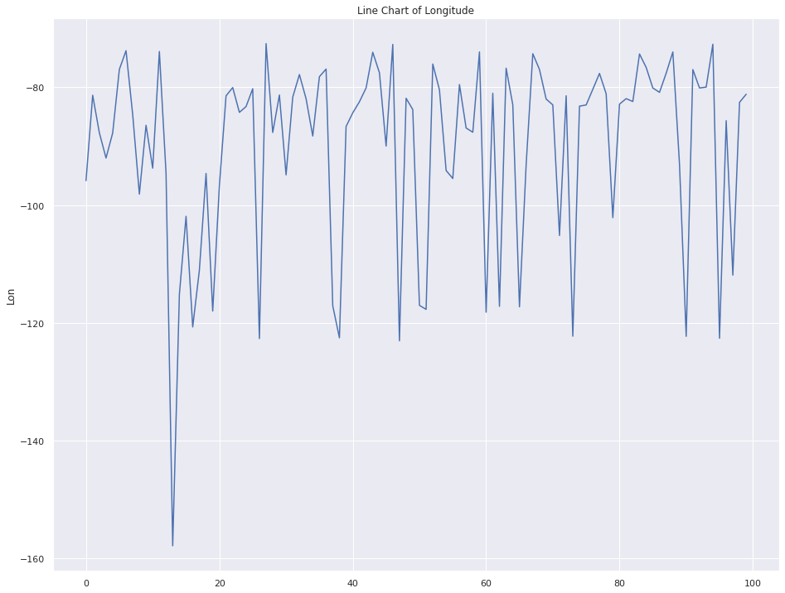
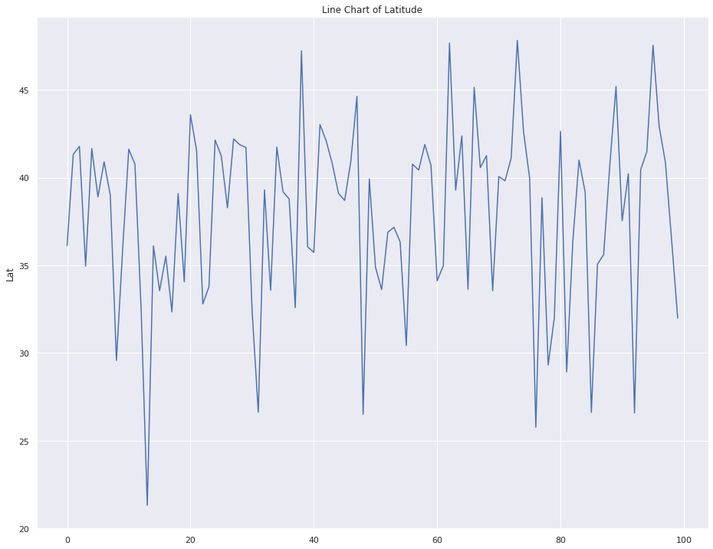
VISUALIZATIONS
Line graph and Scatter Plot is depicting the concentration of restaurants in USA, using Latitude and the Longitude.

Slide 6
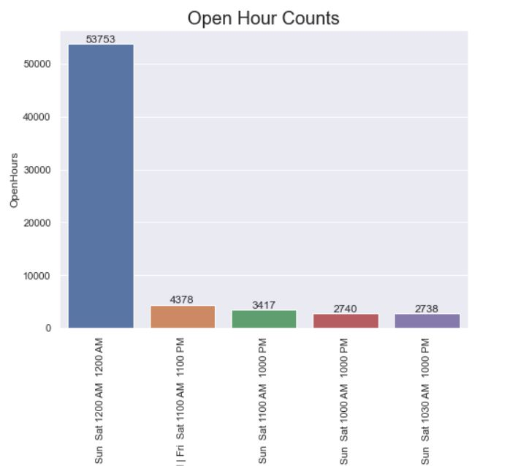
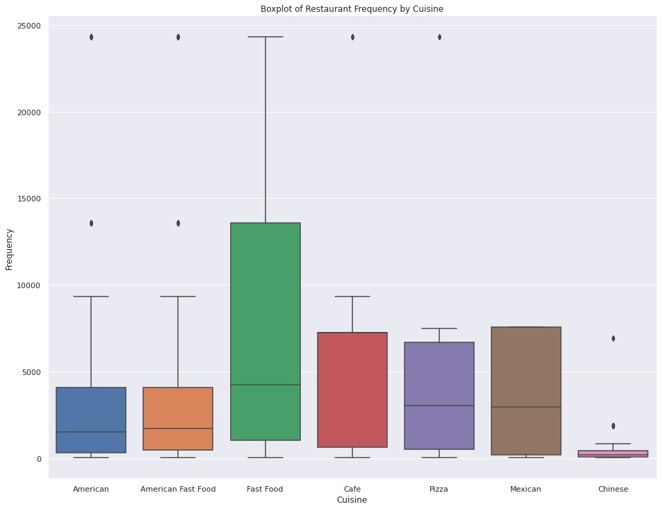
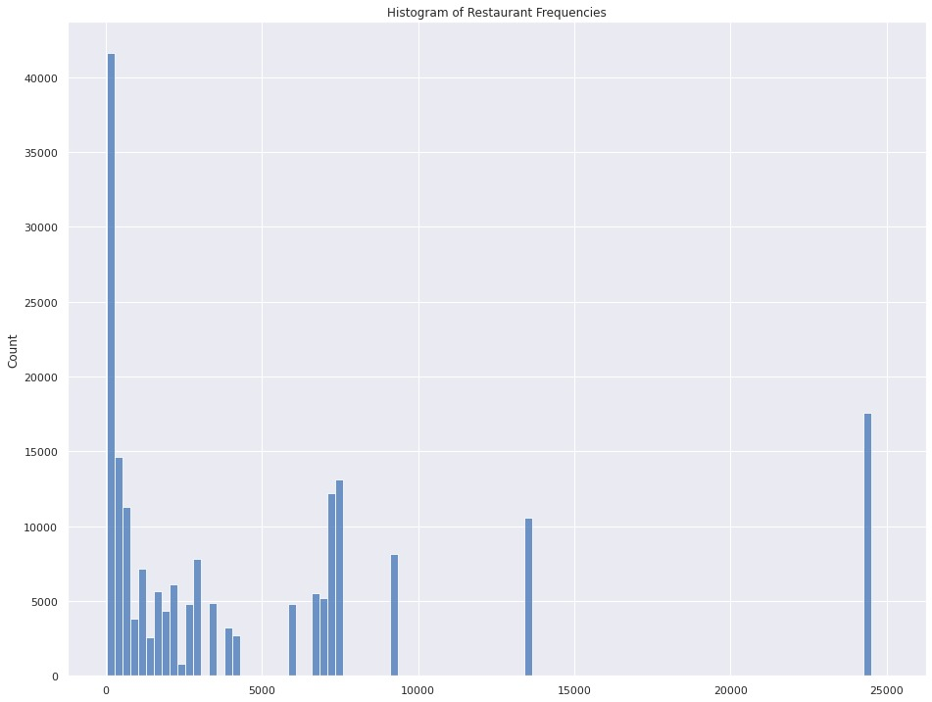
Generalize view of our data
Bar graph represents the count of restaurants operating in those hours.
Box Plot here represents the restaurants frequency by Cuisine for all the states.
Histogram depicts the restaurant frequencies.

Slide 7
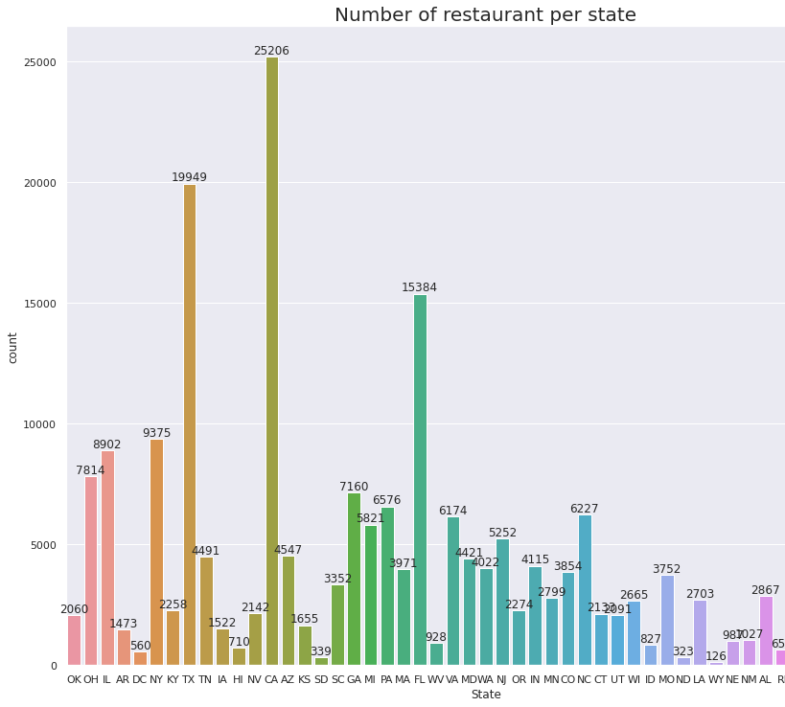
BAR GRAPH
The Bar Chart shows the total number of restaurant per state.
California has the highest number of restaurants i.e 25206 restaurants.

Slide 8
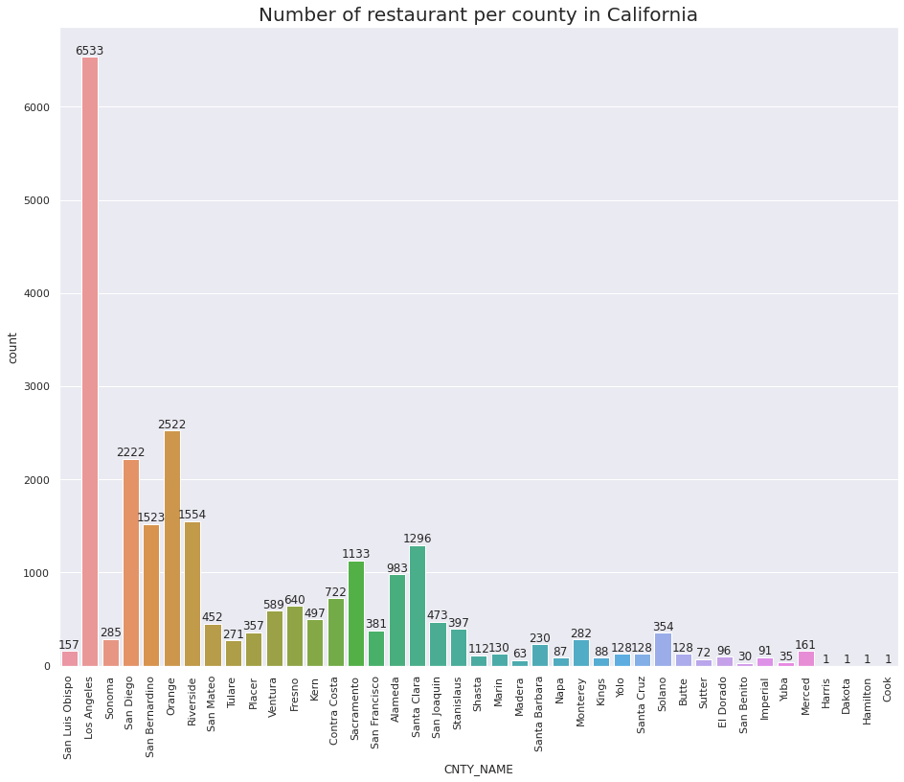
BAR GRAPH DEPICTING THE NUMBER OF RESTAURANTS IN CALIFORNIA
Los Angeles has the highest number of restaurants in California

Slide 9
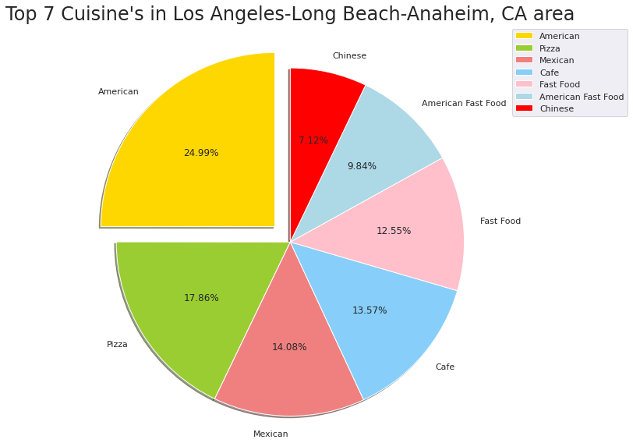
PIE CHART
Pie Chart shown here Top 7 Cuisine’s in Los Angeles – CA area.
This gives us an idea that American Cuisine is mostly preferred in that area.

Slide 10
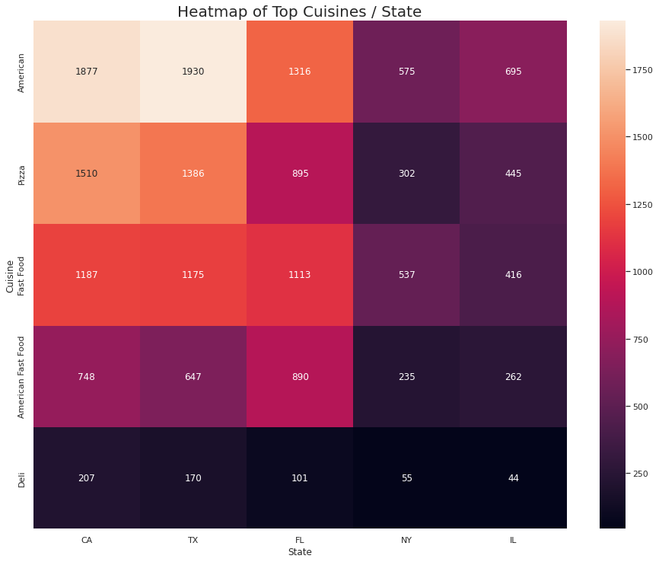
HEAT MAP
Heat Map shown here represents the matrix of top 5 cuisines and states.

Slide 11
CONCLUSION
Conclusions based on Visualization Analysis
California is a hotspot for opening a restaurants due the highest concentration of restaurants within the area.
American is the most preferred cuisines.
Majority of the restaurants operate for a maximum of 12 hours.

Slide 12
RECOMMENDATIONS
Opening a restaurant in LA, California is preferred.
Having American cuisine in a restaurant is preferrable.
Ideally it is recommended to open a restaurant for 12 hours.

Slide 13
SUGGESTIONS
Better conclusion could have been drawn, provided we had information on the following:
Revenue
Ratings
Number of Employees

